Slide 1
Amar Dokan-The Business Media Platform
A Multipurpose Business Platform for connecting all the businessman and the entrepreneur
01
Notes:
Assalamualaikum everyone . The name of our project is “Amar Dokan” the business media platform.

Slide 2
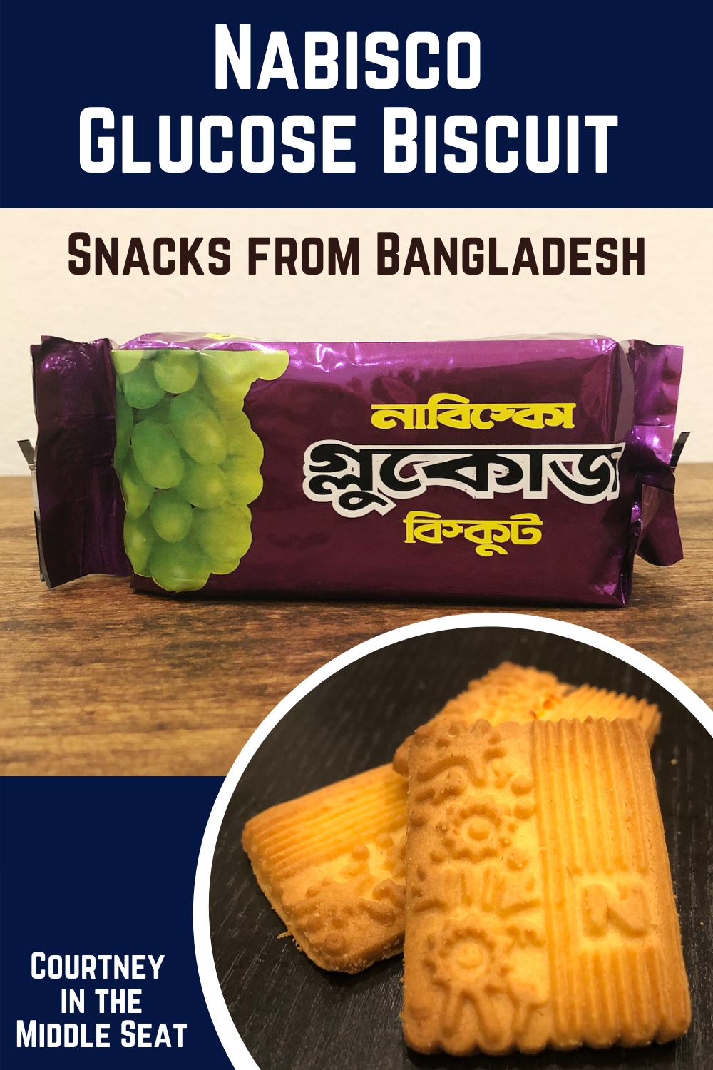
02
Notes:
One day I went to a shop of samiul vai and ask him “Does he have this biscuits”?
Samiul vai: no brother it has finished
Then I went to a next shop near by called “Bokul Uncle’s shop” and I ask him about the biscut
Bokul Uncle: yes son, here you go.you won’t get this biscuit until next month . It is not available in market now. The distribution channel hasn’t enough collection
At afternoon I went to vodra leck for gossiping with my friends and I found a small shop which has a descend stock of it. I ask him to give me 2 pack. He offer me If I buy 3 packet then he will give me 5tk discount. After buying I found that the biscuit’s date will expair in 2 month. This biscuit’s are too old.

Slide 3
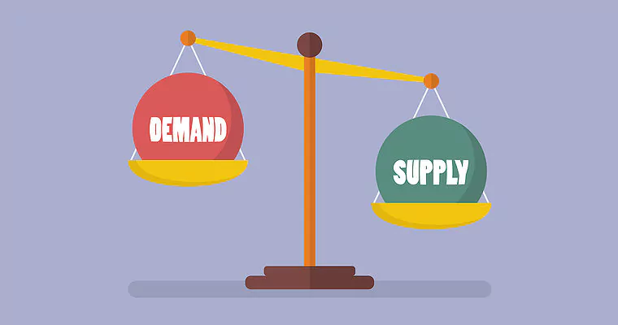
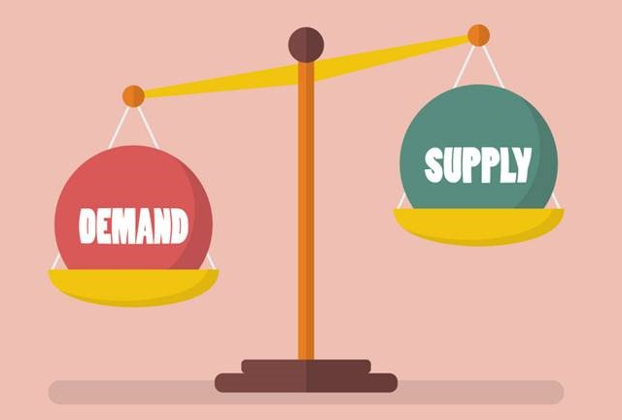
Problem
Low Demand − High Stock
High Demand − Low Stock
03
Notes:
From the discussion we can as address the problem as “ low demand – high stock” & “high stock – Low demand”. Which is very serious issue for startup and business

Slide 4
Case Study
Most of the entrepreneurs are now focusing on online business and e-commerce platform. Here is the
Failure Rate of E-Commerce and Online Business in Bangladesh
https://www.investopedia.com/articles/personal-finance/040915/how-many-startups-fail-and-why.asp
04
Notes:
The study says almost 90% new startup or business , failed to survive within the first 15 years. Same thing is happening in Bangladesh also.

Slide 5

Reasons for this colossal failure
Failure to differentiate the market
Lack of proper business planning and forecasting
Not having the expert idea about running the e-commerce business
Lack of idea about cash flow
Poor Inventory Management System
No ERP system integrated
Poor website and mobile app with less traffic
Lack of patience among a lot of competition
https://brainstation-23.com/ecommerce-failing-bangladesh-part-1/
05
Notes:
We find out some major reasons for this colossal failure like 50% business fail due to ERP.

Slide 6
Solution
We need a platform to connect all customers, Entrepreneur and other Business entities.
And maintaining proper distribution of Goods.
06
Notes:
That’s why our main objective is to ensure that new businessman or entrepreneur does not face any loss in the early stage.
Now the question is how we are going to reach our objective. Well! The solution is simple. We need a platform to connect all the business entities to bring stability to the supply chain by maintaining the proper distribution of the goods.

Slide 7
Introduction
“Amar Dokan- আমার দোকান" is a Facebook like multipurpose Business media platform .
Connect all Business entities.
Our goal is to bring stability in supply chain so that we can bring down the failure rate of entrepreneur.
We will maintain Goods Distribution
07
Notes:
To address the solution let me introduce with our business platform “Amar Dokan” which is basically a multipurpose business media platform like facebook or linkdin.

Slide 8
Types of Seller
01
02
03
Type-1 Seller
Type-2 Seller
Type-3 Seller
Unable to sell due to lack of demand.
Having decent stock
Unable to sell.
low inventory despite high demand
who don’t have connection with supplier or wholesaler
Can’t earn enough profit
08
Notes:
In our platform we divided all the businessman or entrepreneur into 3 categories. 1 seller with =Low Demand−High Stock, 2=High Demand− Low Cost, and 3=New small Businesses which are unable to earn much.

Slide 9
How it will work??
Type2 Seller
Type3 Seller
Type1 Seller
Our Platform
Investor
Consumer
Type1 Seller
Type2 Seller
Type3 Seller
Text 4
09
Notes:
Our main objective is to interconnect these three types of sellers with each other. This way, they can easily meet their respective consumers' demands by transferring or selling their products among themselves.

Slide 10
Fields
Shop
Investment
Product
Company
B2B
B2C
Customers
Suppliers
Shop + Entrepreneur
Short Term
Mid Term
Long Term
ERP Modules
Pocket Money Investment for students
Investors
Accounting
Inventory
HRM
10
Notes:
So our project will work focusing on these three things. Shop, ERP module and Investment.
The concept of shop in our in our platform is like having a virtual copy of the physical store of the business.
We provide global standard ERP module to our clients. If any one need, we provide them with customized ERP module.
Investment has two parts- Products and Company. Anyone can invest in the product. But investing in a company by the investors will be contractual. Here we are establishing a concept of pocket money ivestment.

Slide 11
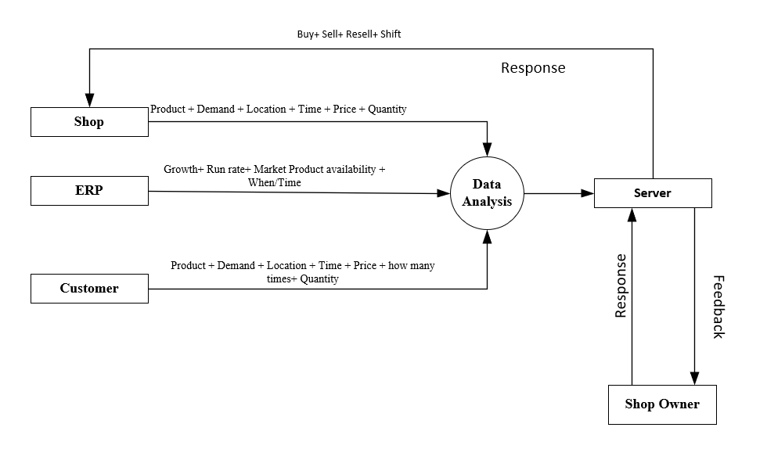
Methodology
11
Notes:
Our methodology is to use all the important parameters like (product, demand, growth etc.) from the shop, ERP and customers and analyze those for giving them a suitable feedback for growing their business.

Slide 12
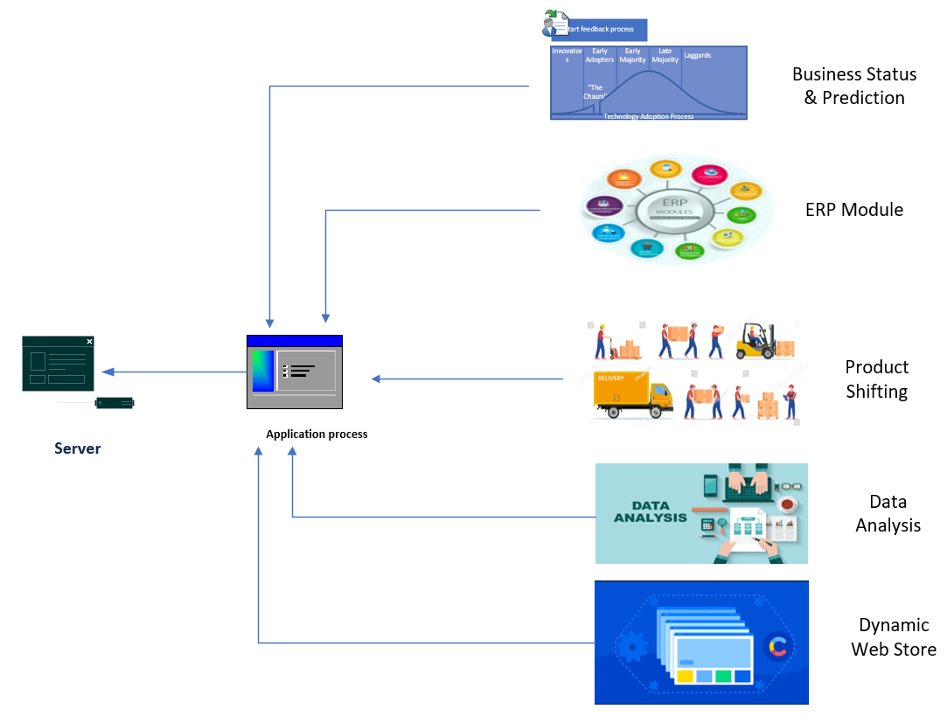
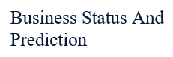
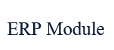
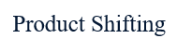
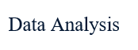
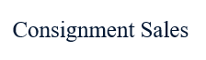
Services
12
Notes:
We will offer various services to our clients. Our revenue model aligns with other online shops and social platforms, primarily based on a subscription model. We will primarily sell features and charge an average monthly fee of 2 tk/day per person.

Slide 13
Uniqueness's
Balancing business with Product Shifting
Consignment sales
Dynamic Web Builder
Entrepreneur Guide line
Nearest Shop finder based on product
Unique ERP based on Global Stander
Target Group (Young Entrepreneur, Ungrown Business, Unsold Product, Underdeveloped business)
Subscription Cost: 2tk/day per person (all in average) , Gross margin 48.6%
Middleman Cutting
24
Notes:
The things make us unique is:
Product shifting: if our system understand that the shop owner facing trouble to sell his product then the system will suggest him to move his product where the product has
proper demand.
consignment selling: we offer consignment selling, which is like drop shipping without buying products. This method is not so popular in Bangladesh, but it has the potential to bring a revolution.
Users will gain access to a dynamic website similar to Daraz, where they can buy and sell products. This service is completely free and will include a sub-IP under our website.
Entrepreneur Guide line: Entrepreneur will understand what should he need to do next according to his business status. like what column of ERP will he need? How his business
growing. What can he do more to grow his business
An entrepreneur will understand what steps they need to take next based on their business status. Questions such as which ERP column is needed, how the business is
growing, and what can be done to further enhance this growth will be clarified.
And the subscription charge is very very low

Slide 14
Target Users
Students
Entrepreneur
Companies
Shops
Total = 10.2M
Total Target = 1.025M
13
Notes:
We categorize our targets in 3 categories. Our total amount of audience is 10.2 million. In the worst case scenario we will get approximately 1.025 million which is 10% of the total audience.

Slide 15

Market Size
Study Period | 2019 - 2029
Market Size (2024) | USD 0.65 Trillion
Market Size (2029) | USD 1.10 Trillion
CAGR (2024 - 2029) | 11.23 %
Serviced Market (2023) | USD 468.51 Billion
14
Notes:
This is the market size. but according to our services the real market is around 6T dollar and CAGR will be18-20%

Slide 16

Estimated Time Frame
Research And Development
First Year
(i) Marketing And Preregistration
Second year
(ii) Feedback And Improvement
Final Product
Third Year
15
Notes:
This is out 3 year time frame

Slide 17
Costing
Research & Development
GUI Design
Buying API
Domain
Hosting
DB Design
Testing
Approval
Feedback & Review
Required Investment: 10 lakh TK
21
Notes:
To reach our goals in initial stage, and for our first prototype, we will need investment approximately 10 lakh tk.

Slide 18
Revenue Stream
Target Period of 5 year | Target Period of 3 year
Group No | Target Group (TG) Name | Target Group(TG) | Number of TG (10%) | Revenue (2tk/day) | Profit | Profit Rate | Burn | Burn Rate | Year
Group1 | University Student | 969k | 96k | 70.08M | 34.06M | 48.6% | 36.02M | 51.4% | 3rd
Group2 | Youth(18-29) Without University Student | 2.29M | 200k | 146M | 106M | 72.6% | 40M | 27.4% | 4th
Group3 | Cottage + Micro + Small | 7M | 700k | 511M | 411M | 80.43% | 60M | 19.5% | 5th
Total |  | 10.2M | 1M 25k | 782.08M | 551.06 |  | 136.02
22
Notes:
Here you can see in worst case scenario we can generate this much profit if we able to launch our final product From the third year

Slide 19

Revenue Source
Advertising
Premium Access Subscription
Custom Service
Investment Account
Unsold Stock
Consignment Sales
Transection
Transportation
23
Notes:
These are our primarily revenue source

Slide 20
pppp

Slide 21

Challenges
As it’s a large platform, it will take a lot of time and eligible manpower to implement
Need to raise big fund for organizing
Competitors Reaction
25
Notes:
Now the challenge is we need a huge fund and skilled manpower to organize this platform

Slide 22

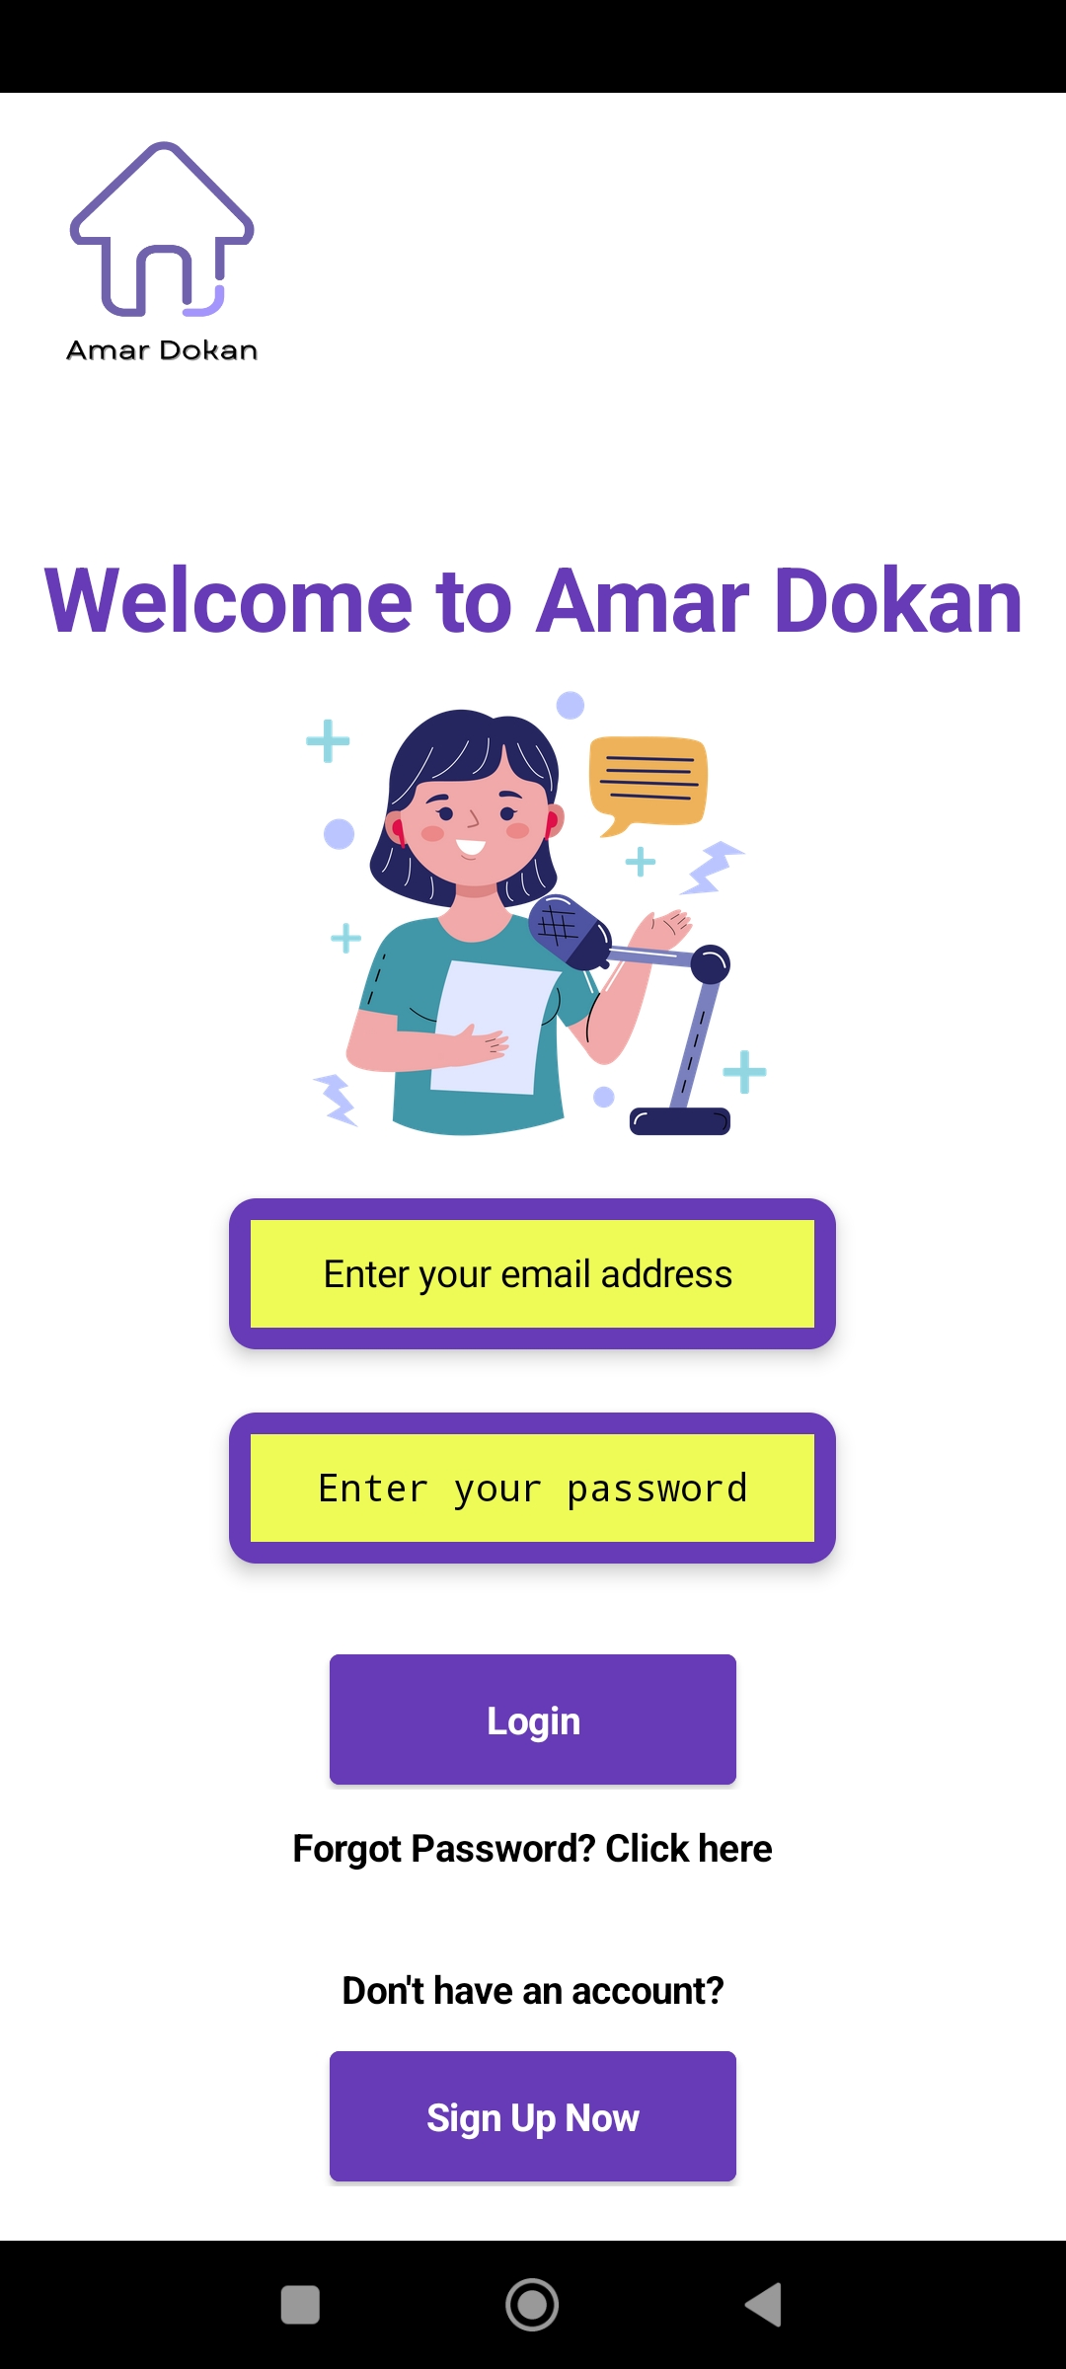
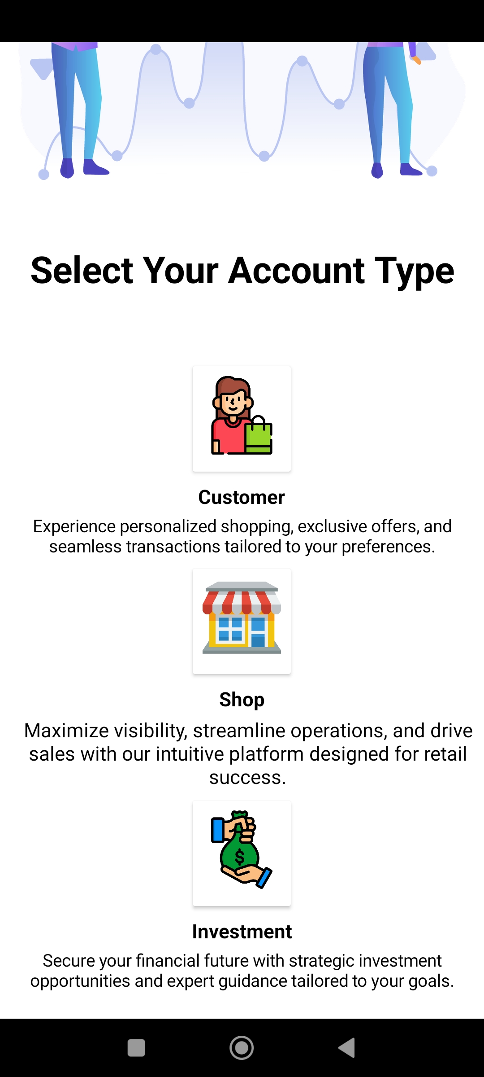
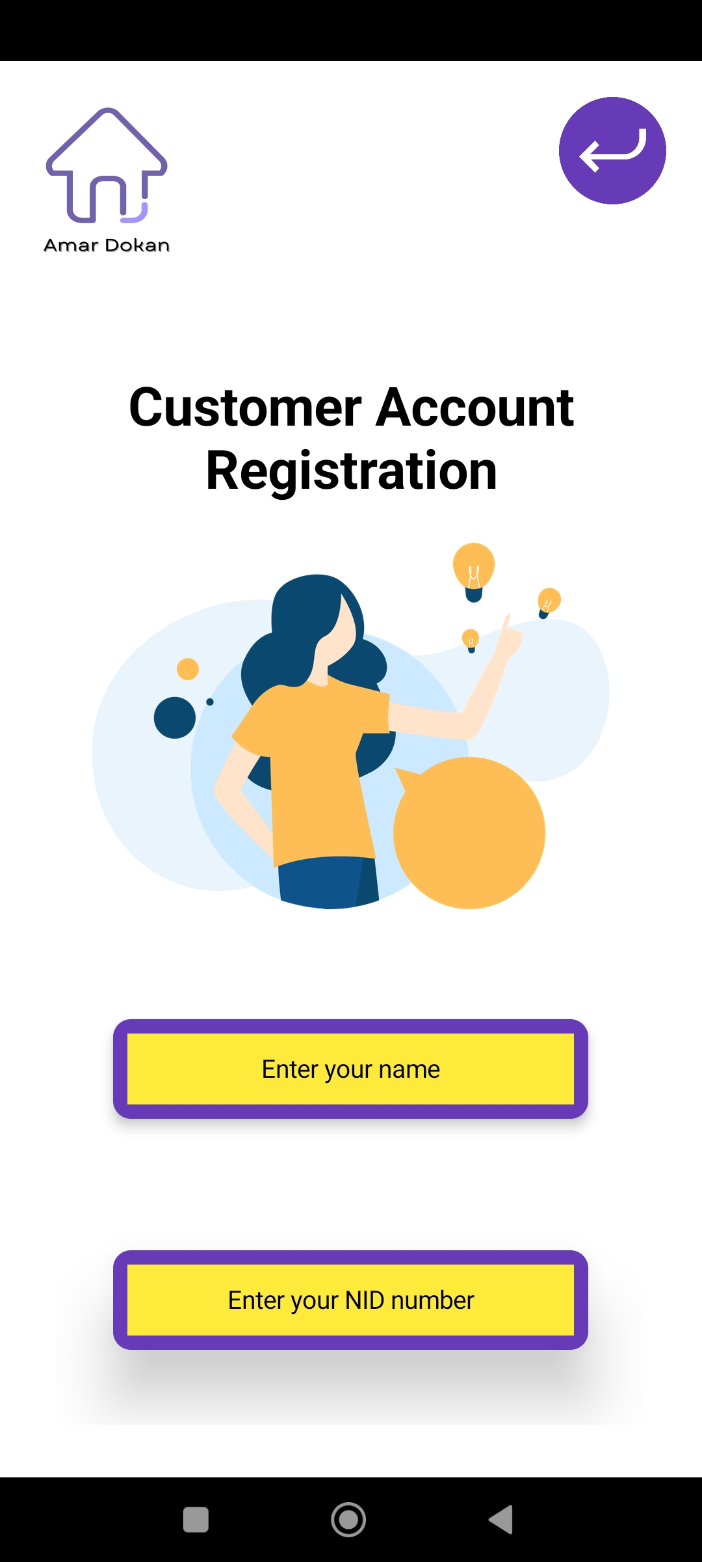
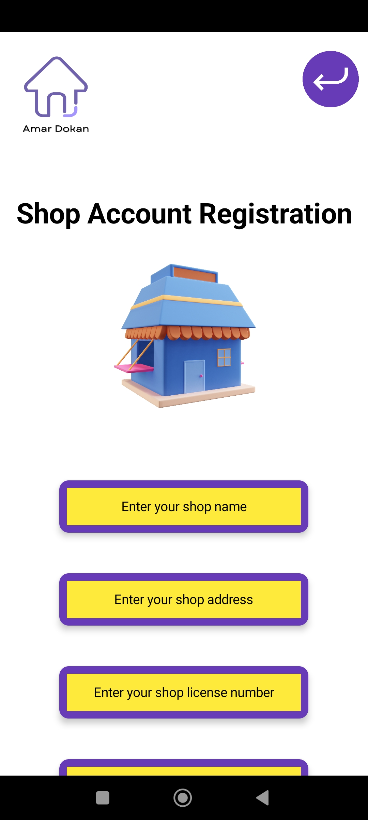
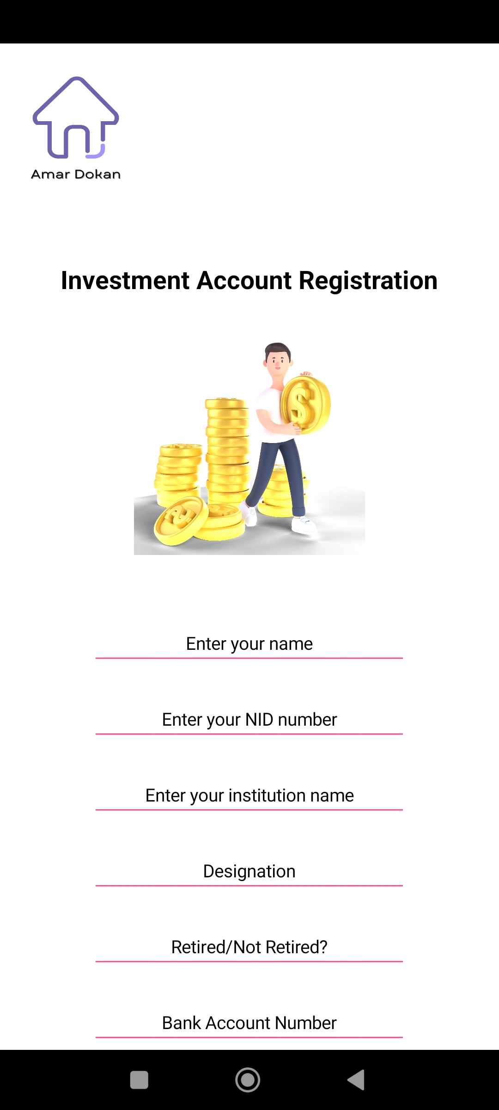
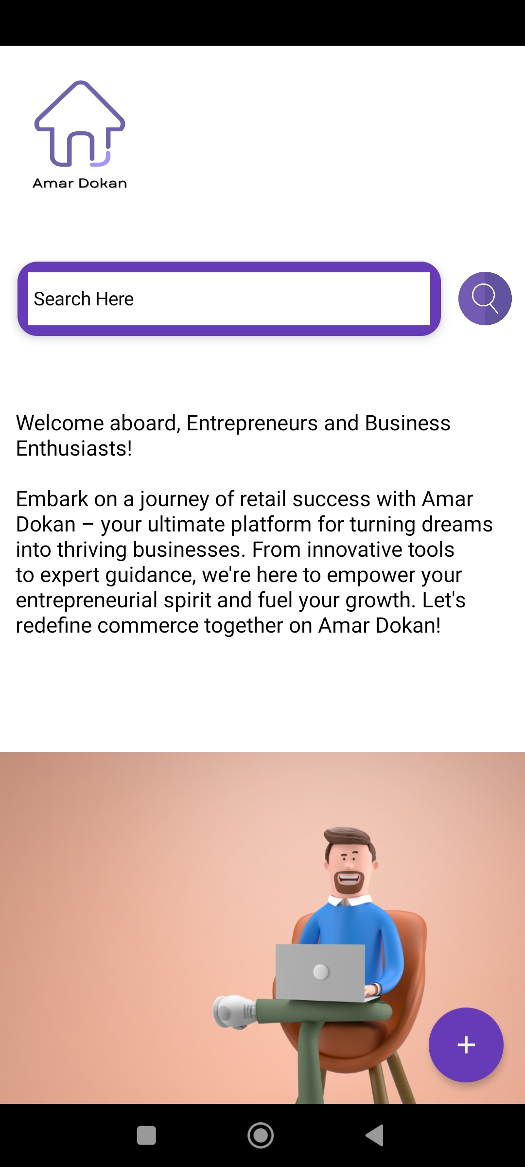
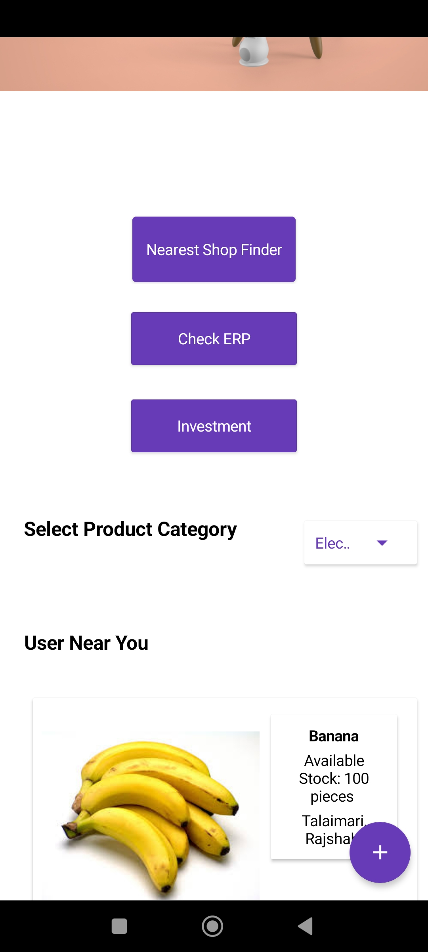
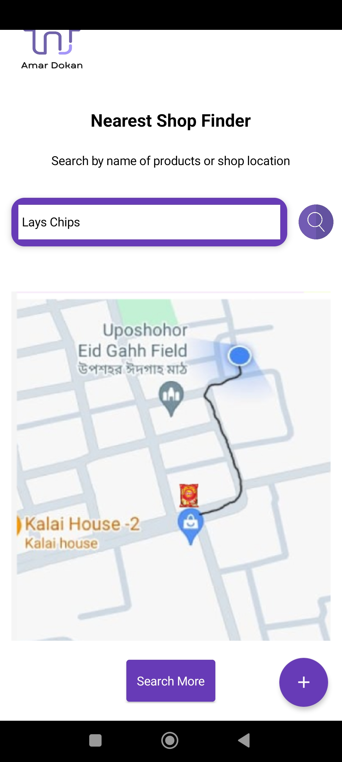
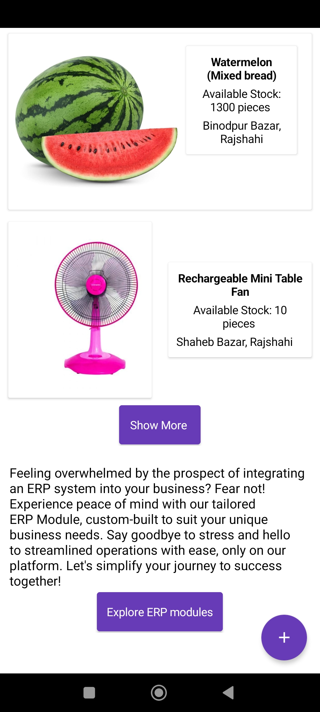
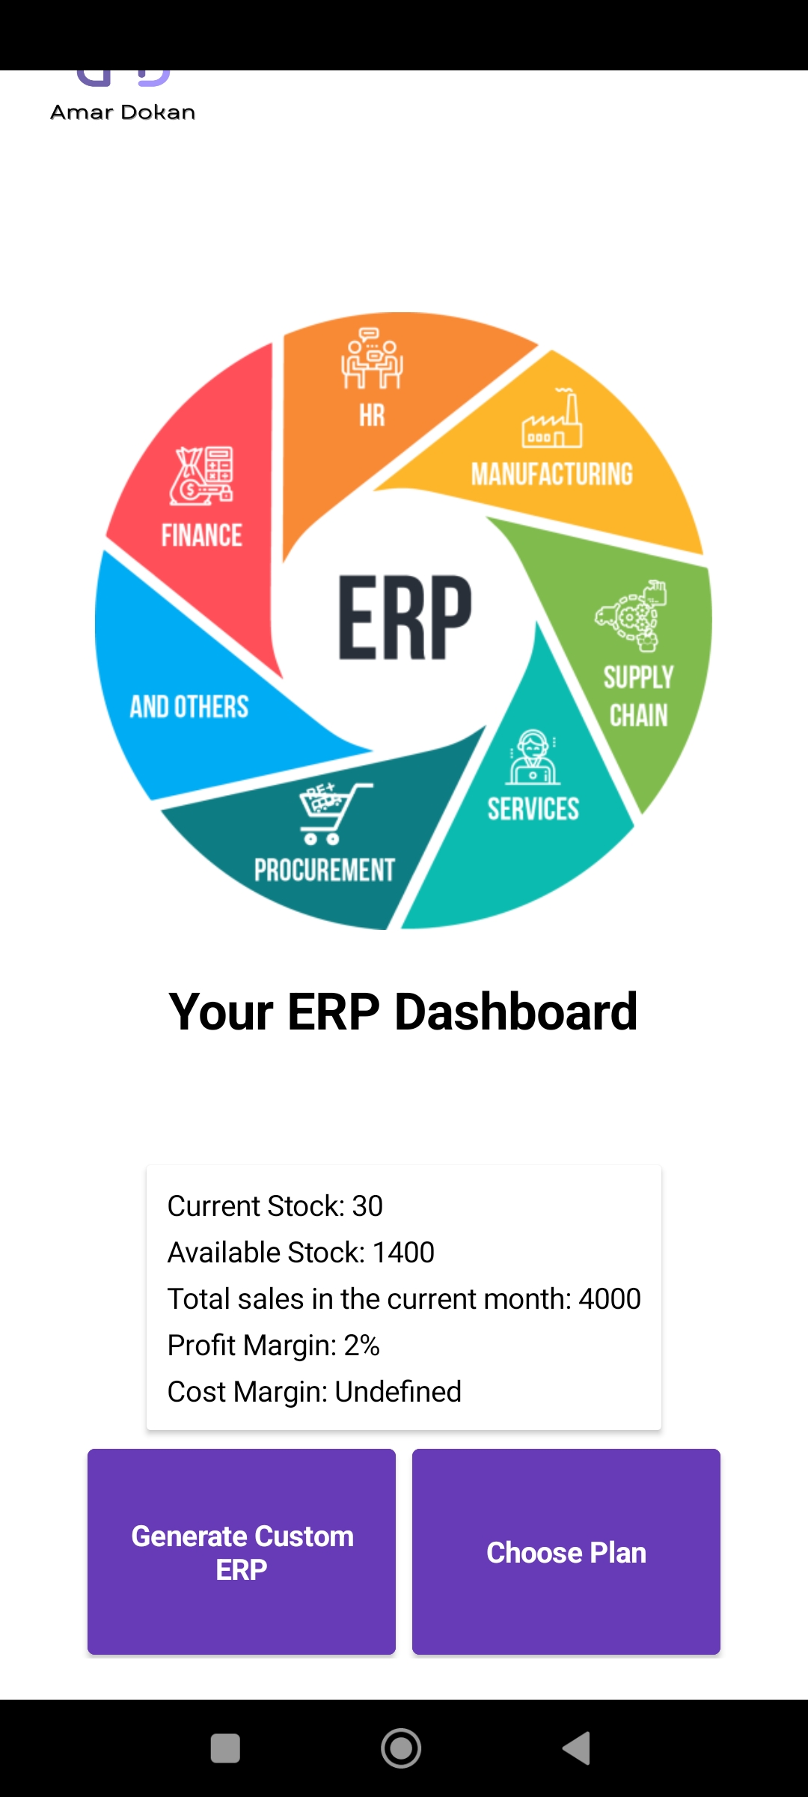
Proof Of Concept
26
Notes:
Here Is the product ‘s Prototypes main feature’s model

Slide 23
References
https://www.investopedia.com/articles/personal-finance/040915/how-many-startups-fail-and-why.asp
https://brainstation-23.com/ecommerce-failing-bangladesh-part-1/
https://explodingtopics.com/blog/startup-failure-stats
https://www.entrepreneur.com/starting-a-business/the-true-failure-rate-of-small-businesses/361350
https://futurestartup.com/2016/04/04/05-startups-failed-bangladesh-last year/#:~:text=Statistically%2C%209%20out%20of%2010,wayside%20and%20die%20silent%20deaths.
https://betterstories.limited/2021/01/20/why-do-start-ups-fail/
https://www.ceicdata.com/en/bangladesh/businesses-registered-statistics
https://markedium.com/smes-of-bangladesh-the-present-scenario-and-future-prospects/#:~:text=The%20industry%20is%20an%20important,are%20established%20in%20rural%20areas.
https://thefinancialexpress.com.bd/views/youth-entrepreneurship-through-smes-can-change-bangladeshs-economic-landscape-1656492318
https://www.thedailystar.net/shout/cover-story/news/the-entrepreneurs-today-1772953
https://www.cnbc.com/2022/03/03/60percent-of-teens-want-to-launch-businesses-instead-of-working-regular-jobs.html
https://www.oecd-ilibrary.org/sites/3ec10f3b-en/index.html?itemId=/content/component/3ec10f3b-en
https://www.youthbusiness.org/what-we-do
https://wpforms.com/the-ultimate-list-of-online-business-statistics/
https://firstsiteguide.com/online-business-stats/
https://www.oberlo.com/blog/ecommerce-statistics
https://www.tbsnews.net/economy/bangladesh-e-commerce-sales-more-double-2026-research-497134
27
Notes:
here is the available references

Slide 24
THANKS!
“ If you don’t get on the road, you can’t recognize the path.
The road doesn’t end until you don’t walk on the path.”
28
Notes:
thank you for hearing us. we are looking forward to your query and suggestion.

Slide 25
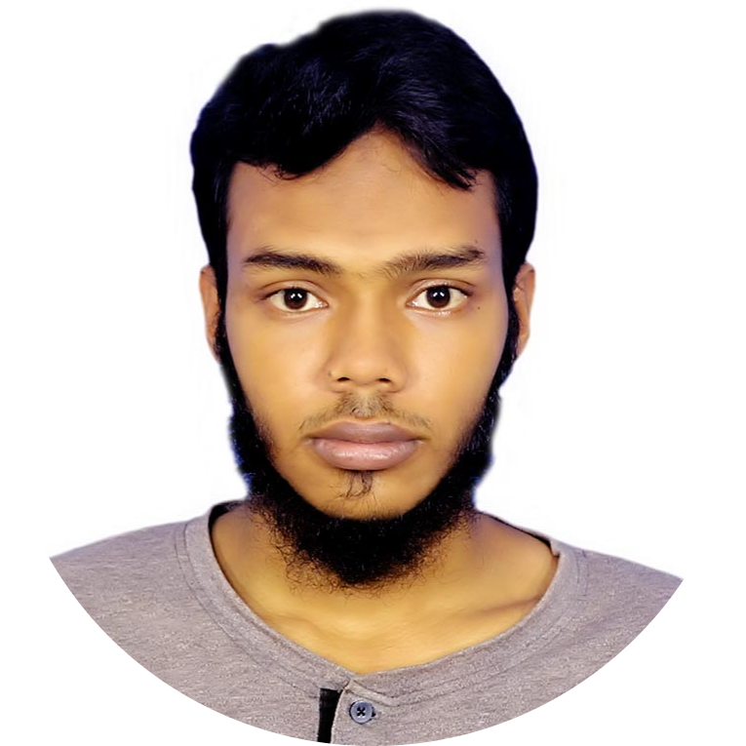
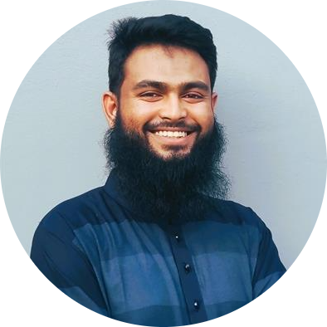
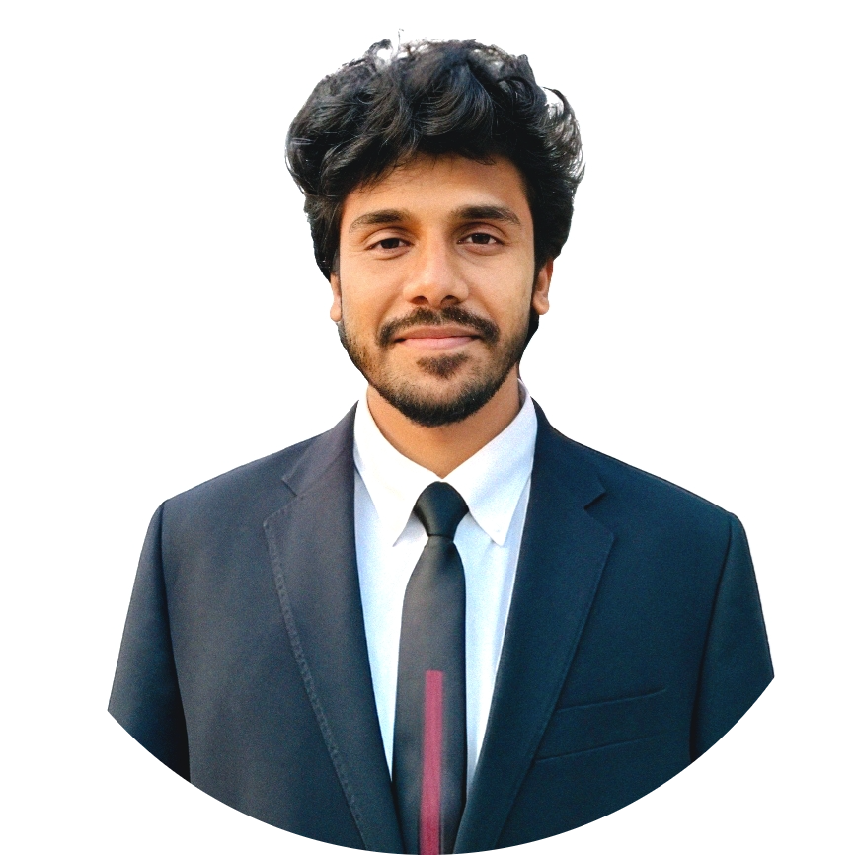
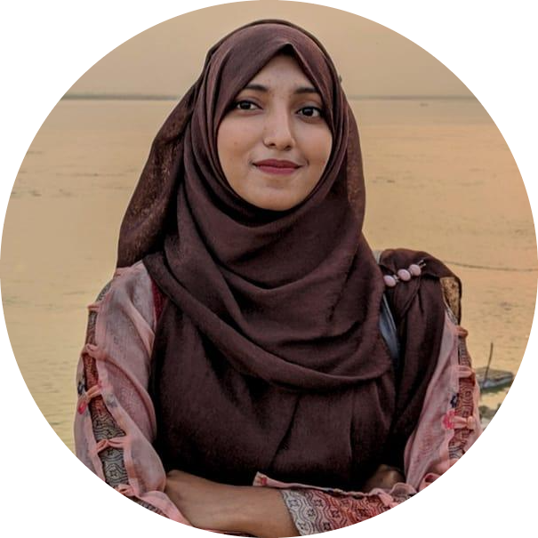
Team Members
Md. Sabbir Al Shafi (Founder)
Dept of CSE, Varendra University
Mahmudul Hasan (CEO)
Dept of CSE, Varendra University
Md. Shadman Saquib (CTO)
Dept of CSE, Varendra University
MD. MUNEM SHAHRIAR(CFO)
Dept of CSE, Varendra University
Mst.Sirazum Munira Mim(CMO)
Dept of CSE, Varendra University
02
Notes:
I am Sirazum Munira Mim from Varendra University, department of CSE. :……………………..Names……………………………..

